Slide 1
Unit 2 Number System and Codes

Slide 2
Number System
Number System is the technique of representing numbers.
Different number systems:
1. Decimal number system (base or radix 10)
uses 10 digits i.e., 0, 1, 2, 3, 4, 5, 6, 7, 8, 9.
2. Binary number system (base 2)
uses only 2 different symbols to represent number i.e., 0 and 1.
3. Octal number system (base 8)
uses 8 different symbols i.e., 0, 1, 2, 3, 4, 5, 6, 7
4. Hexadecimal number system (base 16)
uses 16 different symbols. The first 10 digits is same as in decimal number system and A, B, C, D, E, and F are used for digits 10, 11, 12, 13, 14, and 15 respectively.

Slide 3
Decimal | Binary | Octal | Hexadecimal
0 | 0000 | 0 | 0
1 | 0001 | 1 | 1
2 | 0010 | 2 | 2
3 | 0011 | 3 | 3
4 | 0100 | 4 | 4
5 | 0101 | 5 | 5
6 | 0110 | 6 | 6
7 | 0111 | 7 | 7
8 | 1000 | 10 | 8
9 | 1001 | 11 | 9
10 | 1010 | 12 | A
11 | 1011 | 13 | B
12 | 1100 | 14 | C
13 | 1101 | 15 | D
14 | 1110 | 16 | E
15 | 1111 | 17 | F

Slide 4
Unsigned Binary Numbers
The binary number which only represents the magnitude.
Consider only on magnitude (absolute value) of a number.
All the bits are used to represent magnitude.
For 8-bit number, the range is
(0000 0000)₂ to (1111 1111)₂
or, (00)_{H} to (FF)_{H}
or, (0)₁₀ to (255)₁₀

Slide 5
Signed Magnitude Numbers
consists of both sign and the magnitude.
the leftmost bit is sign bit and the remaining are magnitude bits.
For positive number, sign bit is 0 and for negative number sign bit is 1.
Examples:
+7 → 0000 0111
-7 → 1000 0111
+16 → 0001 0000
-16 → 1001 0000
For 8-bit number, the negative numbers are
1000 0001 (−1) to 1111 1111 (−127)
For 8-bit number, positive numbers are
0000 0001 (+1) to 0111 1111 (+127)
So, for 8-bit arithmetic, the range is − 127 to + 127.

Slide 6
Complements
Complements are used in digital computers to simplify the subtraction operation and for logical manipulation
For base-r system, there are two types of complement.
1. The radix complement (r's complement)
2. The diminished radix complement ((r-1)'s complement)

Slide 7
1) The r’s Complement (Radix Complement)
r’s complement of N = r^{n} – N
where n = no. of digits, N = Number, r = radix
Example:
Find 10's complement of (305)₁₀.
10’s complement of (305)₁₀ = 10³ – 305
= 1000 – 305
= (695) ₁₀

Slide 8
The (r–1)’s Complement (Diminished Radix Complement)
(r–1)’s complement of N = r^{n} – r ^{–m} – N
where N = number, r = radix,
n = an integer of n digits,
m = a fractional part of m digits.
Find 9’s complement of (25.639)₁₀
9’s complement of (25.639)₁₀ = 10² – 10^{–3} – 25.639
= 100 – 0.001–25.639
= (74.36)₁₀

Slide 9
Subtraction using complements
1’s Complement
complement each bit.
change all 1s to 0s and all 0s to 1s.
2’s Complement
Add 1 to the 1’s complement to get 2’s complement.
2’s complement = 1’s complement + 1

Slide 10
Subtraction using 2’s complement
Rules:
Take 2’s complement of negative number
Add it to the positive number
Case i) If there is carry, the number is positive so discard carry and the number is the required answer.
Case ii) If there is no carry, the number is negative so we get 2’s complement of result to get actual result, with negative sign at front.

Slide 11
Weighted and non-weighted Codes
Weighted codes:
Positionally weighted codes
Each digit is assigned a specific weight according to its position. Examples: Decimal, Binary, Octal, BCD, 2421 codes
Non- weighted codes:
Positionally not weighted codes.
Digit position of any numbers does not represent the specific weight.
Examples: Excess-3 code, Gray code.

Slide 12
Binary-Coded Decimal (BCD) 8421 Code
each decimal digits is represented by binary code of four bits.
BCD for 0 to 9 is same as binary.
Decimal BCD 0 0000 1 0001 9 1001 10 0001 0000 15 0001 0101 100 0001 0000 0000

Slide 13
Merits:
easy to encode and decode decimals into BCD and vice versa.
simple to implement a hardware algorithm for the BCD converter.
useful in digital systems whenever decimal information is given either as inputs or displayed as outputs.
Demerits:
For integers greater than 9, BCD occupies more space than the corresponding binary. For example, Decimal : 13 Binary : 1101 BCD code : 0001 0011
require a complex design of ALU than binary number system.

Slide 14
Different Binary codes for decimal digit
Decimal | BCD(8421) code | 2421 code | Excess-3 code | 84-2-1 code
0 | 0000 | 0000 | 0011 | 0000
1 | 0001 | 0001 | 0100 | 0111
2 | 0010 | 0010 | 0101 | 0110
3 | 0011 | 0011 | 0110 | 0101
4 | 0100 | 0100 | 0111 | 0100
5 | 0101 | 1011 | 1000 | 1011
6 | 0110 | 1100 | 1001 | 1010
7 | 0111 | 1101 | 1010 | 1001
8 | 1000 | 1110 | 1011 | 1000
9 | 1001 | 1111 | 1100 | 1111
Unused bit combinations | 1010 | 0101 | 0000 | 0001
 | 1011 | 0110 | 0001 | 0010
 | 1100 | 0111 | 0010 | 0011
 | 1101 | 1000 | 1101 | 1100
 | 1110 | 1001 | 1110 | 1101
 | 1111 | 1010 | 1111 | 1110

Slide 15
2421 code and 84-2-1 code
Self complementing code ,i.e, 1's complement of the coded number yields 9's complement of the number itself.
Reciprocating codes

Slide 16
Excess-3 Code(Xs-3 code)
4-bit code sometimes used with binary-coded decimal(BCD) numbers.
To convert any decimal number into its excess-3 form, we have to add 3 to each decimal digit, and then convert the sum to a BCD number.
Self-complimenting code/ Reflective code. Example: Convert 29 to an excess-3 code. 2+3=5 0101
9+3=12 1100
So, (29)10=(01011100)Excess -3 code

Slide 17
Gray Code
Gray code is un weighted and is not an arithmetic code.
In gray code, the bits are arranged in such a way that it changes by only one bit as it sequences from one number to next.
Binary code | Gray code
000 | 000
001 | 001
010 | 011
011 | 010
100 | 110

Slide 18
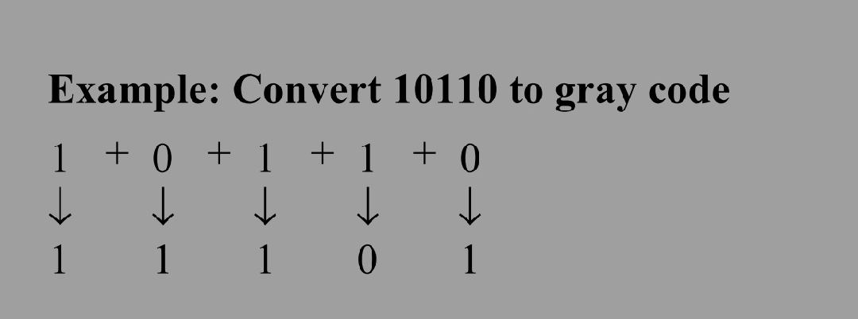
Binary to gray code conversion
Keep MSB of gray code same as MSB of binary code.
Going from left to right, add adjacent pairs of binary code to get next gray code bit.
Discard any carries.
So, (10110)2=(11101)gray code

Slide 19
Gray to binary conversion
Keep MSB of binary code same as of gray code.
Add each binary code generated to the gray code bit in the next adjacent.
Discard any carries.
Convert 110111 gray code to binary
Gray 1 1 0 1 1 1
+ + + + +
Binary 1 0 0 1 0 1
So, (110111)gray code=(100101)2

Slide 20
Alphanumeric codes
ASCII Code
American Standard Code for Information Interchange.
alpha-numerical code used in computers and electronic equipments.
EBCDIC
stands for Extended Binary Coded Decimal Interchange Code.
8 bit alphanumeric code developed by IBM, supports 256 symbols.
mainly used in IBM mainframe computers.
General letters/numbers | ASCII(Decimal)
0-9 | 48-57
A-Z | 65-90
a-z | 97-122

Slide 21
Instruction code
group of bits that instructs the computer or processor to perform a specific function.
consist of operation codes also known as opcodes and operation part specifying the address of operand and result.
Example:
MVI A ,45H
MOV C,A
ADD C
HLT
Opcode | Operand | Hex code | Remarks
MVI | A,45H | 3EH 45H | Loads the accumulator with byte 45 H
MOV | C,A | 4FH | Copies content of C to B.
ADD | C | 89H | Adds content of A and C and stores result in A.
HLT |  | 76H | Ends the program

Slide 22
END OF UNIT 2

